Slide 1
Computer Graphics: 3D – Transforms
Tommy Marrinan, PhD

Slide 2
Geometric Transforms
Similar to 2D, but now in 3D
Affect position, size, and orientation of models
Only modifies vertices
Edges remain in tact

Slide 3

Translate
$T\left(t_{x},t_{y},t_{z}\right)=\left[\begin{matrix}1 & 0 & 0 & t_{x} \\ 0 & 1 & 0 & t_{y} \\ 0 & 0 & 1 & t_{z} \\ 0 & 0 & 0 & 1\end{matrix}\right]$

Slide 4

Scale
S$\left(s_{x},s_{y},s_{z}\right)=\left[\begin{matrix}s_{x} & 0 & 0 & 0 \\ 0 & s_{y} & 0 & 0 \\ 0 & 0 & s_{z} & 0 \\ 0 & 0 & 0 & 1\end{matrix}\right]$

Slide 5
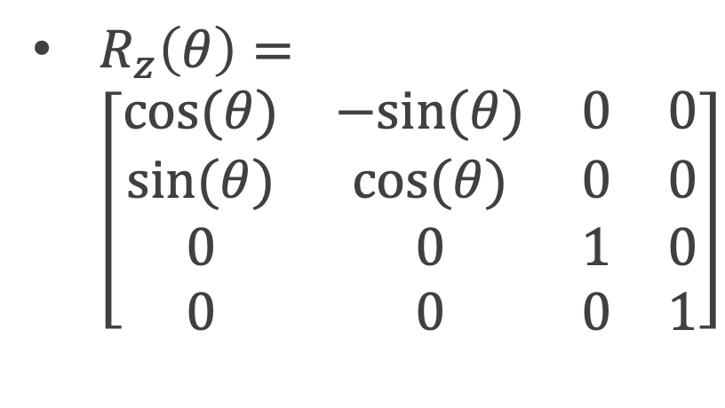
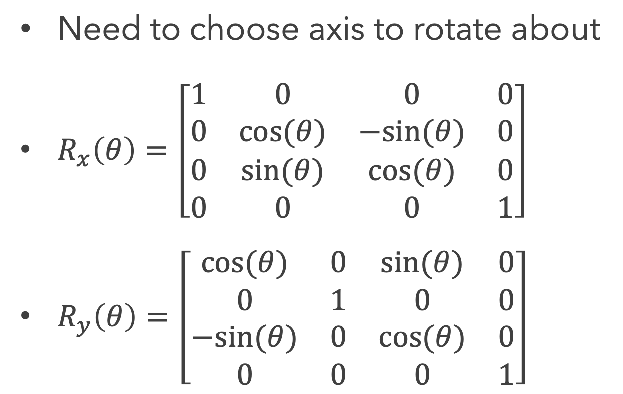
Rotate
Need to choose axis to rotate about
$R_{x}\left(θ\right)=\left[\begin{matrix}1 & 0 & 0 & 0 \\ 0 & cos⁡(θ) & −sin⁡(θ) & 0 \\ 0 & sin⁡(θ) & cos⁡(θ) & 0 \\ 0 & 0 & 0 & 1\end{matrix}\right]$
$R_{y}\left(θ\right)=\left[\begin{matrix}cos⁡(θ) & 0 & sin⁡(θ) & 0 \\ 0 & 1 & 0 & 0 \\ −sin⁡(θ) & 0 & cos⁡(θ) & 0 \\ 0 & 0 & 0 & 1\end{matrix}\right]$
$R_{z}\left(θ\right)=$ $\left[\begin{matrix}cos⁡(θ) & −sin⁡(θ) & 0 & 0 \\ sin⁡(θ) & cos⁡(θ) & 0 & 0 \\ 0 & 0 & 1 & 0 \\ 0 & 0 & 0 & 1\end{matrix}\right]$

Slide 6
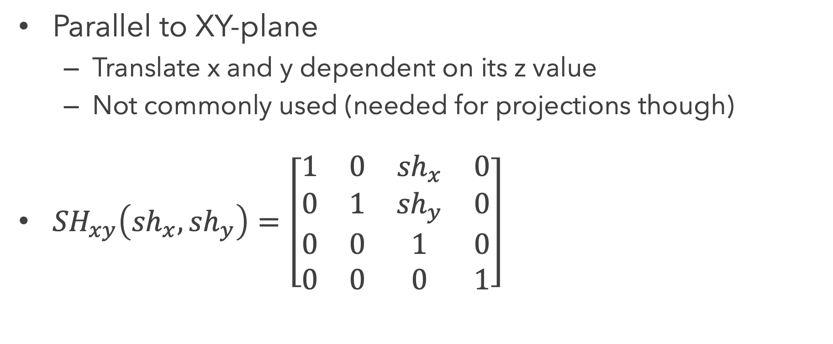
Shear
Parallel to XY-plane
Translate x and y dependent on its z value
Not commonly used (needed for projections though)
${SH}_{xy}\left({sh}_{x},{sh}_{y}\right)=\left[\begin{matrix}1 & 0 & {sh}_{x} & 0 \\ 0 & 1 & {sh}_{y} & 0 \\ 0 & 0 & 1 & 0 \\ 0 & 0 & 0 & 1\end{matrix}\right]$

